Slide 1
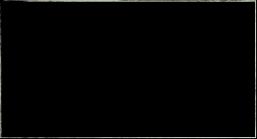

AI Saturdays
AI6 Week 2
Oxygen AI
Optimize Your Outcomes
AI6 Registration Form: https://docs.google.com/forms/d/e/1FAIpQLSd0wx35dx1NJI2C_ciyzoplneu1igltvEACI5KLN6FPWrhO8w/viewform
Notes:
AI6 Registration Form: https://docs.google.com/forms/d/e/1FAIpQLSd0wx35dx1NJI2C_ciyzoplneu1igltvEACI5KLN6FPWrhO8w/viewform

Slide 2
Agenda
845AM – Sign-in
910AM - Fast AI Discussion
10AM - Break
1030AM - CS224n Discussion
1130 - Break
12PM Close
Fast AI Lesson 1
CS224n Lecture 1
Other Items
Interest in MXNet
Study Kera-based FastAI

Slide 3

Fast AI – Week 2
Pre-Work
Links with video and lesson wikis:
Pytorch Version: http://course.fast.ai/lessons/lesson2.html Keras Version: http://course17.fast.ai/lessons/lesson2.html • Minimum: Watch the video; run through the Notebook • Ideal: Recreate the code from scratch without aid in your own notebook

Slide 4
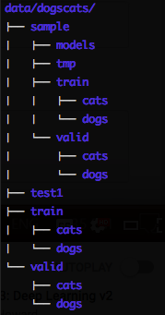
Fast.AI Lesson 2:
Improving Your Image Classifier
Key Coding Concepts
Data Augmentation Tips:
‘tfms=’ & ‘precompute=True’
transform_side_on. & transform_top_down
Folder Structure for Image Classification
”cycle_len = 1” ; Enables SGDR
Cycle = interval before learning rate reset
Cycle length = # of epochs before per cycle
learn.save
learn.unfreeze() – unfreeze all the layers
Differential Learning Rate – Using an array of learning rates for each layer
lr=np.array([1e-4,1e-3,1e-2])
“cycle_mult” = cycle length multiplier after each cycle
“learn.TTA” – Test Time Augmentation

Slide 5

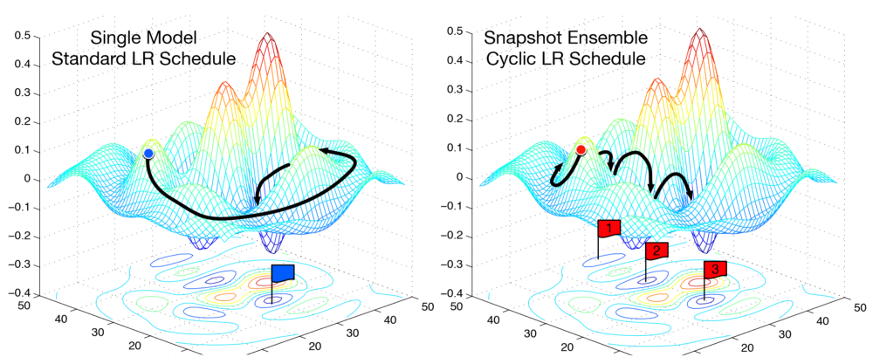
Fast.AI Lesson 2:
Improving Your Image Classifier
Key Theoretical Concepts
Finding the Best Learning Rate
Learning Rate Annealing; Cosine Annealing
CNN Activations
Stochastic Gradient Descent w/ Restarts (SGDR)
Evaluating Model Performance
Confusion Matrix
Notes:
AI6 Registration Form: https://docs.google.com/forms/d/e/1FAIpQLSd0wx35dx1NJI2C_ciyzoplneu1igltvEACI5KLN6FPWrhO8w/viewform

Slide 6
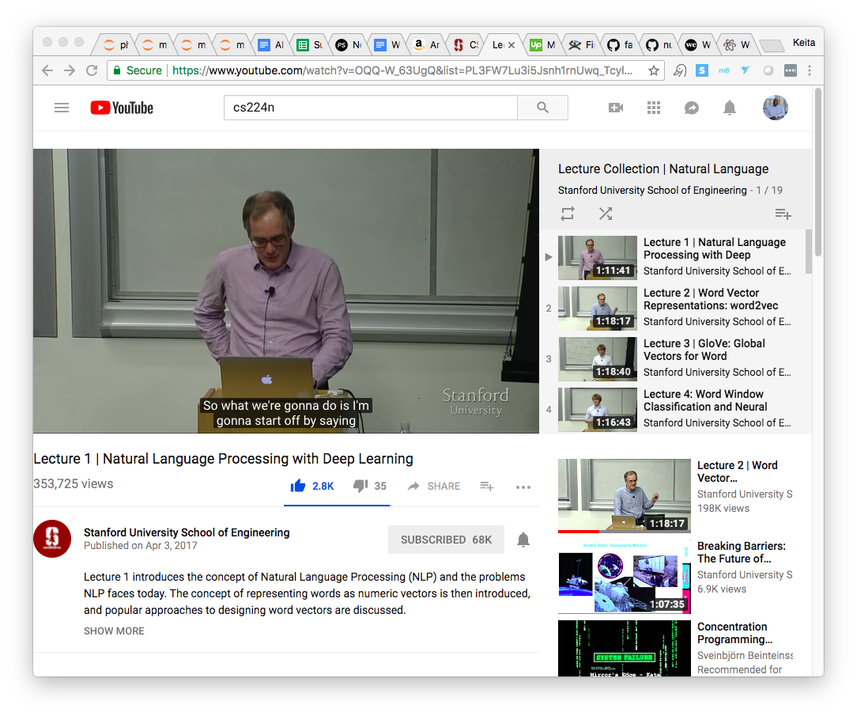
CS224n – Lecture 2
WORD VECTORS 1
Pre-Work
VIDEO: https://www.youtube.com/watch?v=ERibwqs9p38&index=2&list=PL3FW7Lu3i5Jsnh1rnUwq_TcylNr7EkRe6 SLIDES: http://web.stanford.edu/class/cs224n/lectures/lecture2.pdf
Suggested Readings: Found in http://web.stanford.edu/class/cs224n/syllabus.html 1. [Word2Vec Tutorial - The Skip-Gram Model] 2. [Distributed Representations of Words and Phrases and their Compositionality] 3. [Efficient Estimation of Word Representations in Vector Space]

Slide 7
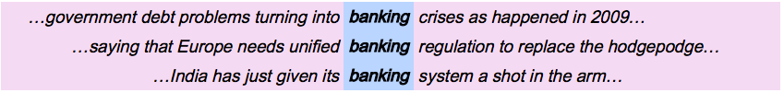
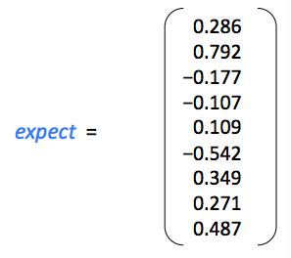
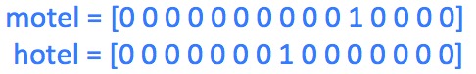
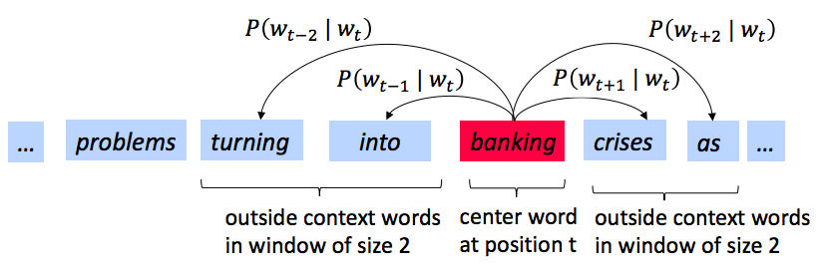
CS224n Lecture 2
Key Theoretical Concepts
Word Meaning
WordNet: Database of synonym sets & hypernyms (“is a”)
Lot’s of problems with Wordnet-type resources
Discrete symbols: 1-Hot Representation
Almost impossible to do word similarity
Represent Word Meaning using Context
A words meaning is given by the words it frequently appears close by
Word2vec
We have a large corpus of text
Every word in a fixed vocabulary is represented by a vector
Go through each position t in the text, which has a center word c and context (“outside”) words o
Use the similarity of the word vectors for c and o to calculate the probability of o given c (or vice versa)
Keep adjusting the word vectors to maximize this probability
Pictured Implementation is Skip-Gram Model
Notes:
AI6 Registration Form: https://docs.google.com/forms/d/e/1FAIpQLSd0wx35dx1NJI2C_ciyzoplneu1igltvEACI5KLN6FPWrhO8w/viewform

Slide 8
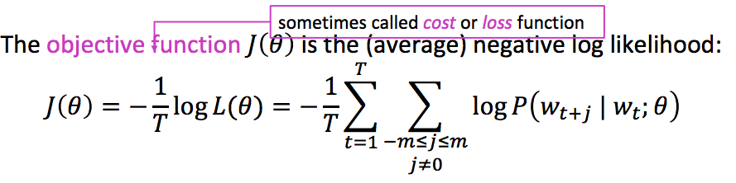
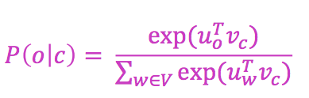
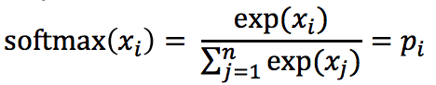
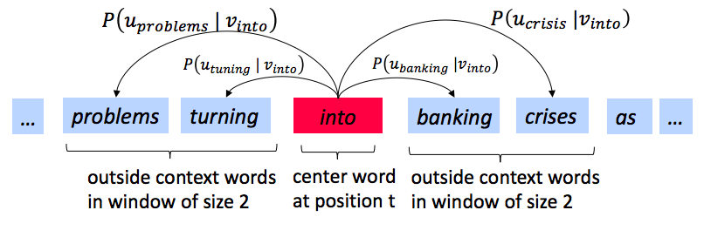
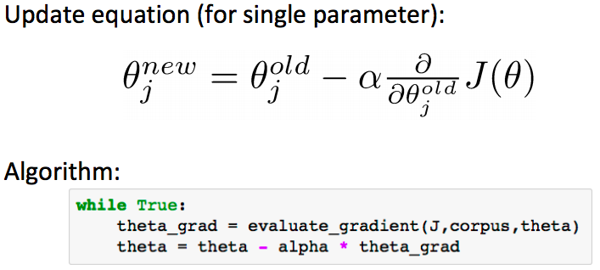
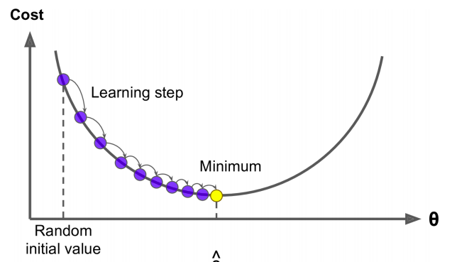
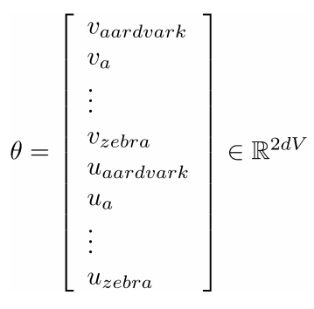
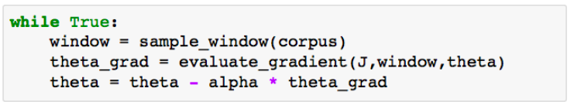
CS224n Lecture 2
Key Theoretical Concepts, Cont.
Objective Function
With language, humans leave a lot for others to infer
Prediction Function
Example of Softmax Function
“max” because amplifies probability of largest x
“soft” because still assigns some probability to smaller x
Process for Calculating
Windowing process
GD & SGD
Theta
Theta represents all model parameters, in one long vector
Notes:
AI6 Registration Form: https://docs.google.com/forms/d/e/1FAIpQLSd0wx35dx1NJI2C_ciyzoplneu1igltvEACI5KLN6FPWrhO8w/viewform

Slide 9
Backup

Slide 10
Curriculum
Fast.ai - Practical Deep Learning For Coders - Part 1
Stanford CS224n: NLP with Deep Learning

Slide 11
Fast AI Detailed Overview
“Learn how to build state of the art models without needing graduate-level math—but also without dumbing anything down.”
Weekly Course Content
Recognizing Cats and Dogs
Improving Your Image Classifier
Understanding Convolutions
Structured, Time Series & Language Models
Collaborative Filtering. Inside the Training Loop
Interpreting Embeddings. RNN from Scratch
Resnets from Scratch

Slide 12
CS224n Detailed Overview
Weekly Course Content
Intro to NLP & Deep Learning
Word Vectors 1
Word Vectors 2
Neural Networks
Back Propagation
Intro to TensorFlow
Dependency Parsing
RNN and Language Models
Vanishing Gradients, Fancy RNNs
Machine Translation, Seq2Seq and Attention
Advanced Attention
Transformer Networks and CNNs
Co-reference Resolution
Tree RNNs and Constituency Parsing
Advanced Architectures and Memory Networks
Reinforcement Learning for NLP
Semi-Supervised Learning for NLP
Future of NLP Models, Multi-task Learning and QA Systems
“Students will learn to implement, train, debug, visualize and invent their own neural network models.”
Notes:
Syllabus: http://web.stanford.edu/class/cs224n/syllabus.html

